Slide 1

ENVIRONMENTAL SOUND CLASSIFICATION USING DEEP LEARNING

Slide 2
Problem formulation
Intelligent sound detection(ISR) is a technology for identifying sound events that exist in the real environment and embedding such ability in machines or robots.
Environmental sound classification(ESC) serve as a fundamental steps of ISR.
The main goal of ESC is to precisely classify the class of a detected sound.
Automatic speech recognition (ASR) and music information recognition (MIR) will be inefficient when applying to non stationary ESC task because environmental sound is non stationary in nature.
Therefore, it is essential to develop an efficient ISR system for environment sound(ES) recognition.
The main obstacles of current algorithms for ESC task are
1) log-mel and MFCC are the most widely used acoustic features applied to ESC, but were originally designed for ASR and MIR. ES is non stationary signal and using single features lead to the failure of capturing the important information about Environmental sound.
2) In recent years neural network has gained popularity for environmental sound classification. However performance is still unsatisfactory.
Hence, there is a need to develop appropriate auditory features and novel neural network models to achieve high categorization accuracy for ESC tasks.
Environmental sound classification using deep learning - Manoj

Slide 3
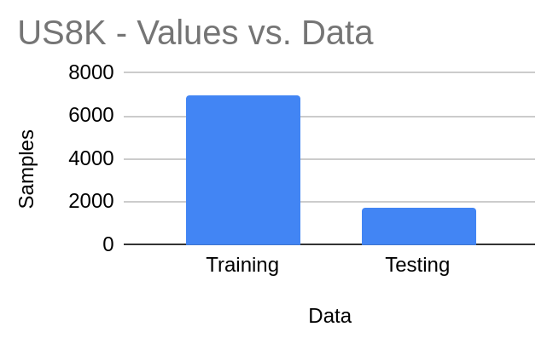
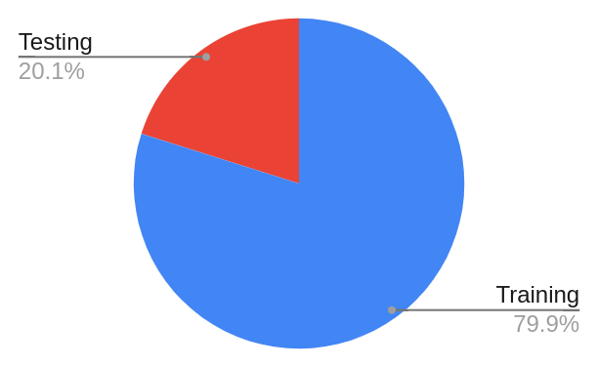
Dataset
[1] Urbansound8k [3]:
This dataset contains 8732 labeled sound of 〜4 sec length in WAV format at 22.05 kHz.
10 classes were defined: air_conditioner, car_horn, children_playing, dog_bark, drilling, enginge_idling, gun_shot, jackhammer, siren, and street_music.
Nearly 870 slices of data per class.
Environmental sound classification using deep learning - Manoj

Slide 4
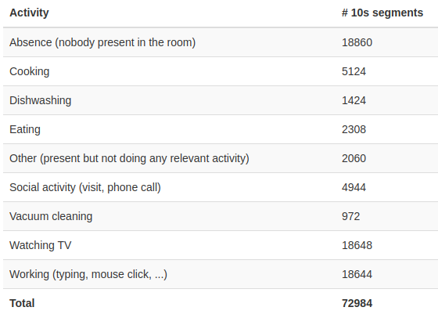
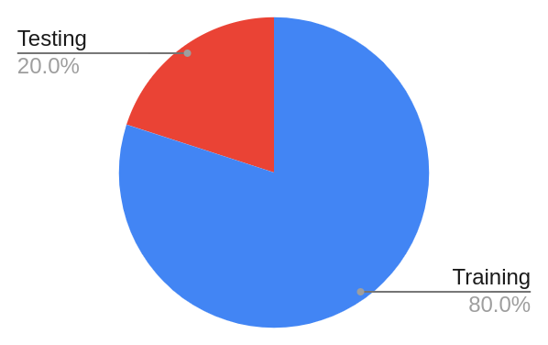
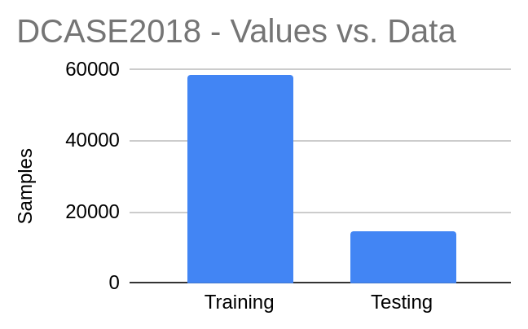
Dataset
[3] DCASE 2018, Monitoring of domestic activities based on multi-channel acoustics
Total of 72984, 10 sec audio dataset.
The continuous recordings in home environment were split into audio segments of 10s.
9 classes were considered,
Environmental sound classification using deep learning - Manoj

Slide 5
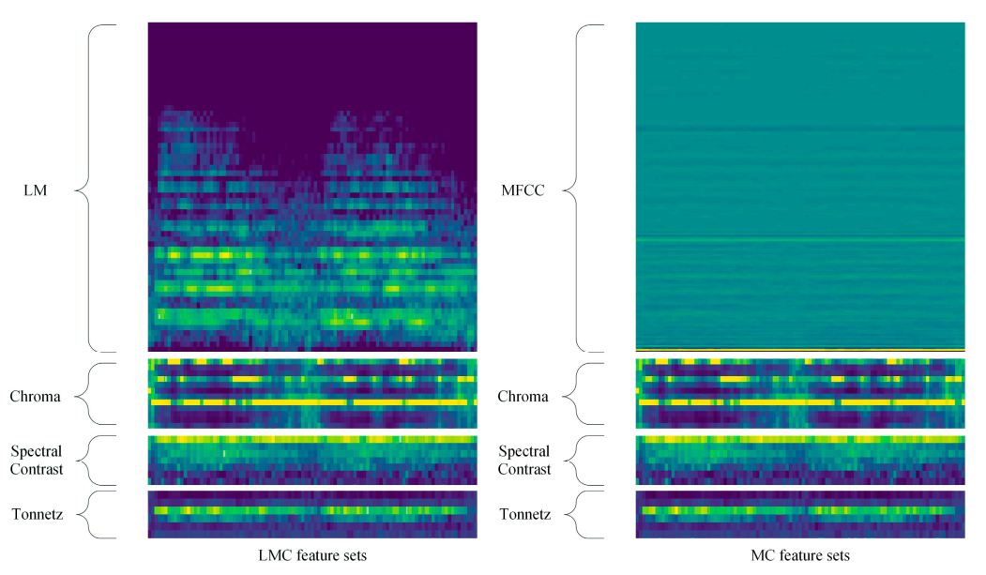
Acoustic feature
Courtesy:Environment Sound Classification Using a Two-Stream CNN Based on Decision-Level Fusion
Yu Su 1,2,* , Ke Zhang 1, Jingyu Wang 1 and Kurosh Madani 2
Figure 3: The spectrogram of LMC and MC feature sets
Environmental sound classification using deep learning - Manoj

Slide 6
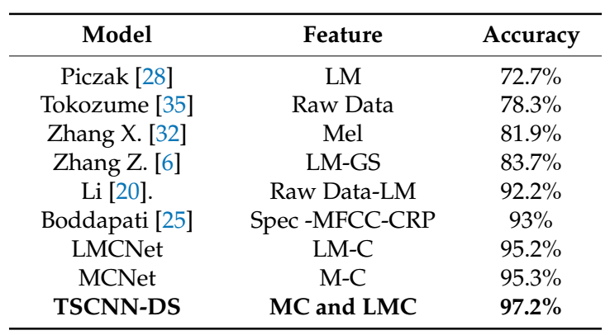
Courtesy:Environment Sound Classification Using a Two-Stream CNN Based on Decision-Level Fusion. Yu Su 1,2,* , Ke Zhang 1, Jingyu Wang 1 and Kurosh Madani 2
Table2. Comparison of classification accuracy with other models on UrbanSound8K datasets.
Environmental sound classification using deep learning - Manoj

Slide 7
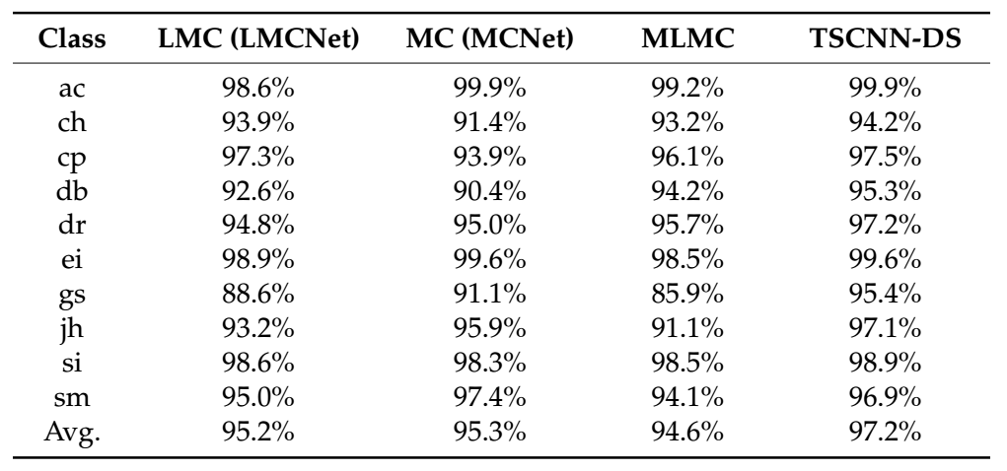
Courtesy:Environment Sound Classification Using a Two-Stream CNN Based on Decision-Level Fusion. Yu Su 1,2,* , Ke Zhang 1, Jingyu Wang 1 and Kurosh Madani 2
Table 1. Class-wise accuracy of four models with four-layer CNN evaluated on UrbanSound8K
Environmental sound classification using deep learning - Manoj

Slide 8
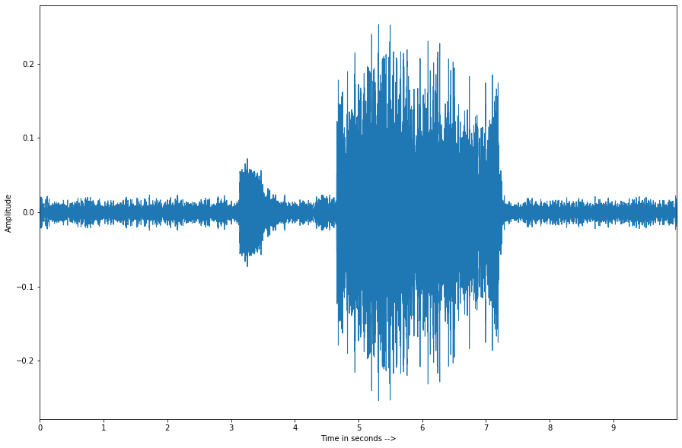
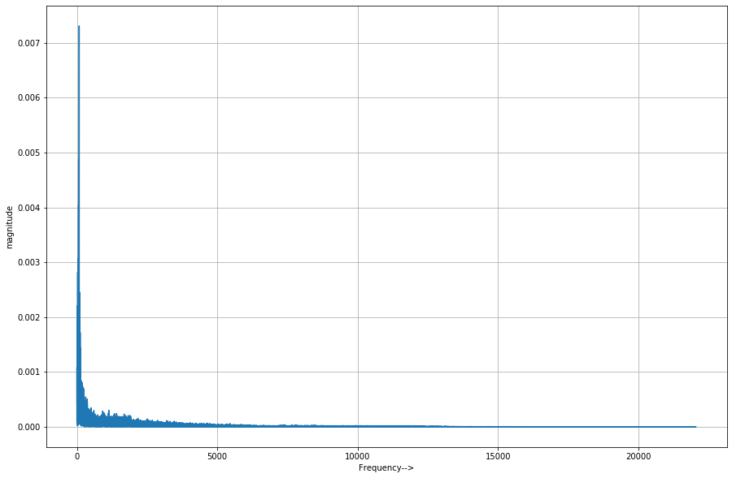
Sound
Environmental sound classification using deep learning - Manoj

Slide 9
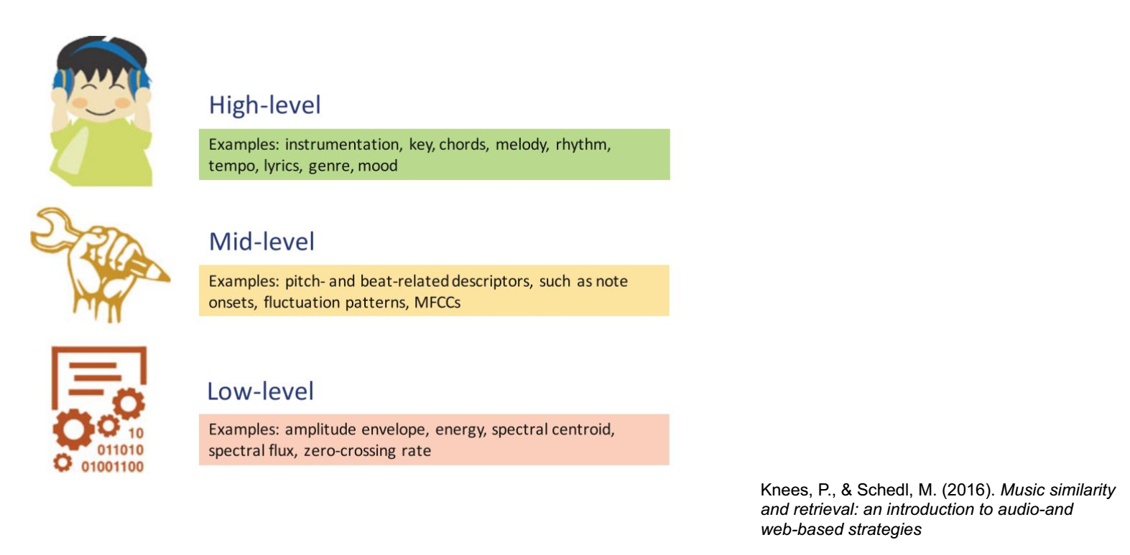
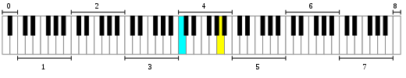
Acoustic features
MFCC
Mel spectrogram
Environmental sound classification using deep learning - Manoj

Slide 10
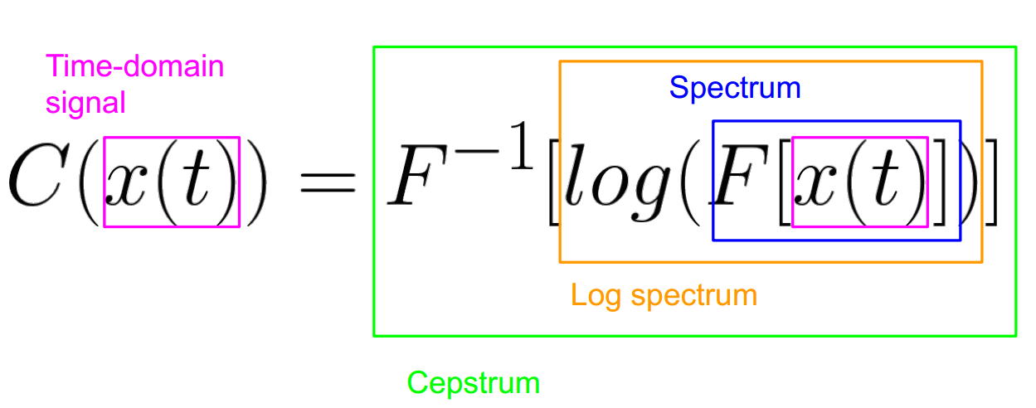
Acoustic features: MFCC
Mel-Frequency Cepstral Coefficients.
[5]
Environmental sound classification using deep learning - Manoj

Slide 11
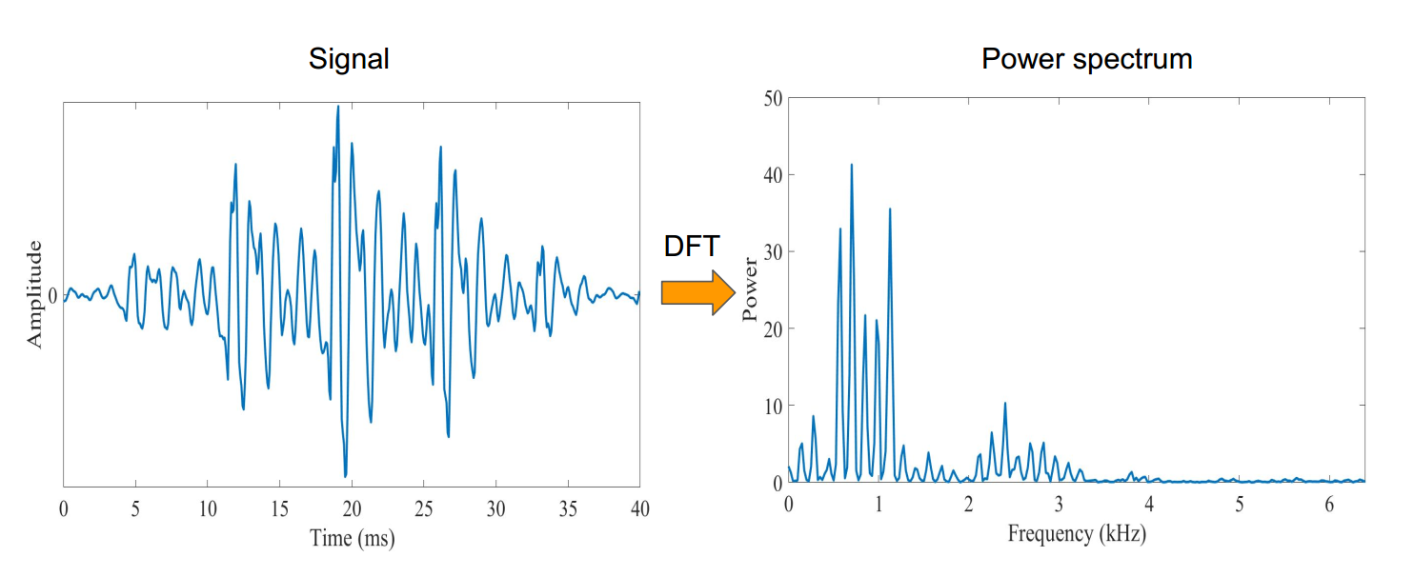
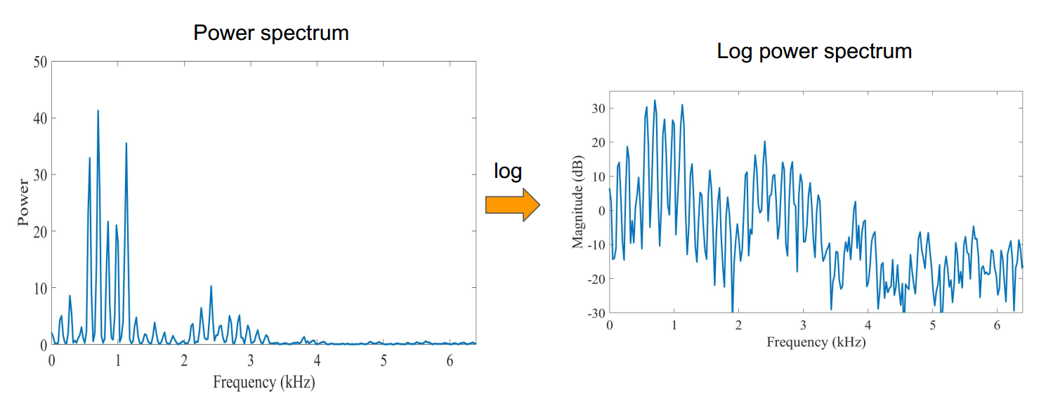
Acoustic features: MFCC
[5]
Environmental sound classification using deep learning - Manoj

Slide 12
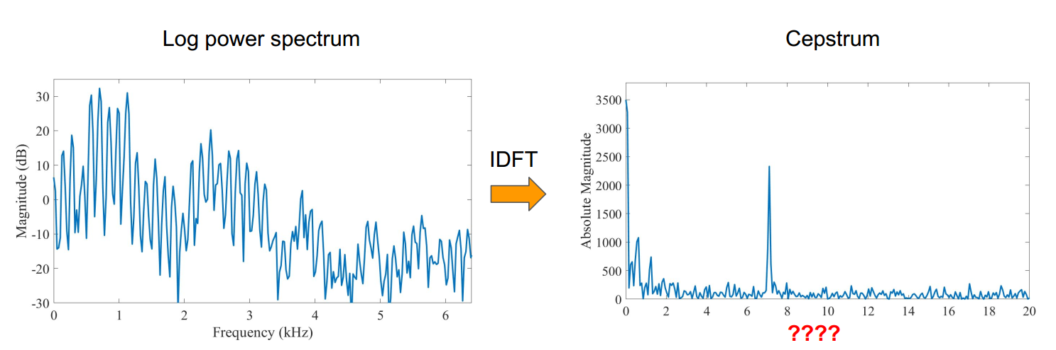
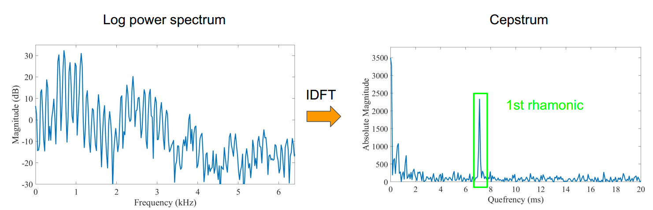
Acoustic features: MFCC
[5]
Environmental sound classification using deep learning - Manoj

Slide 13
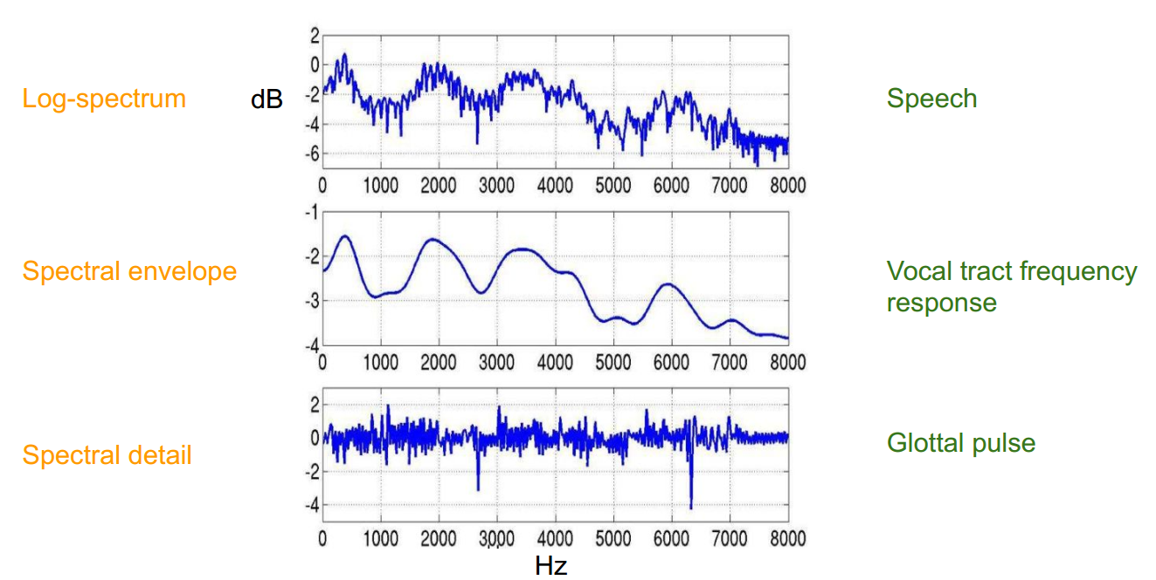
Acoustic features: MFCC
[5]
Environmental sound classification using deep learning - Manoj

Slide 14
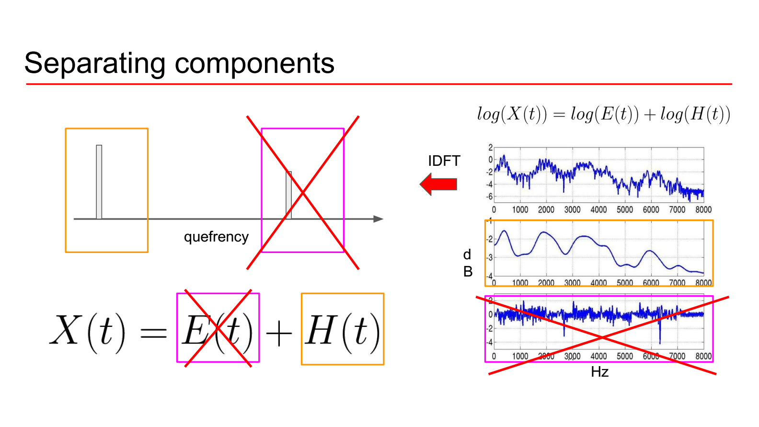
Acoustic features: MFCC
[5]
Environmental sound classification using deep learning - Manoj

Slide 15
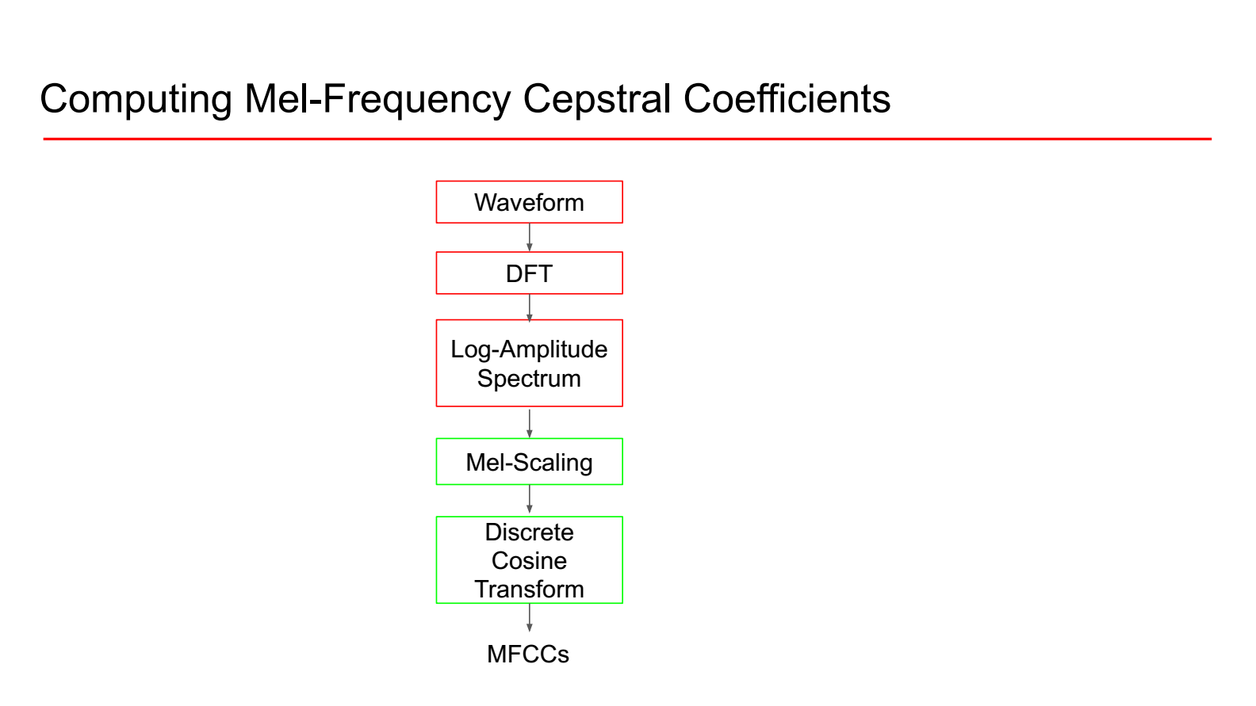
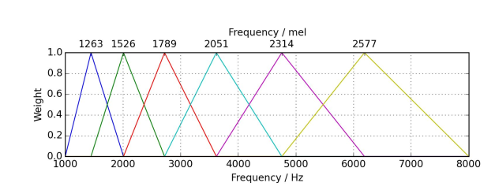
Acoustic features: MFCC
[5]
Environmental sound classification using deep learning - Manoj

Slide 16
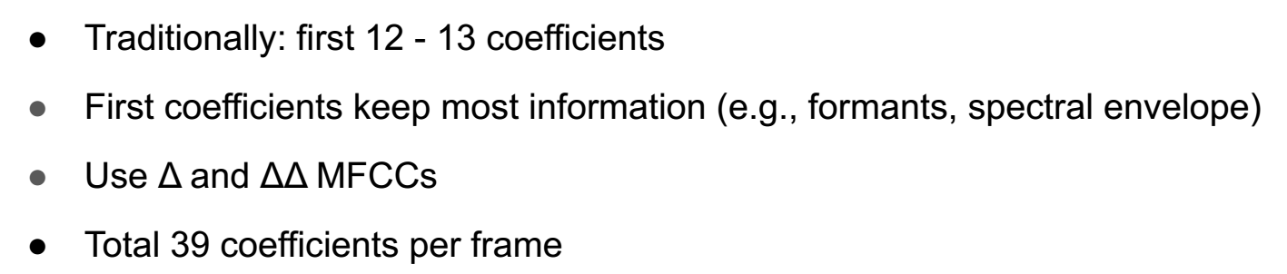
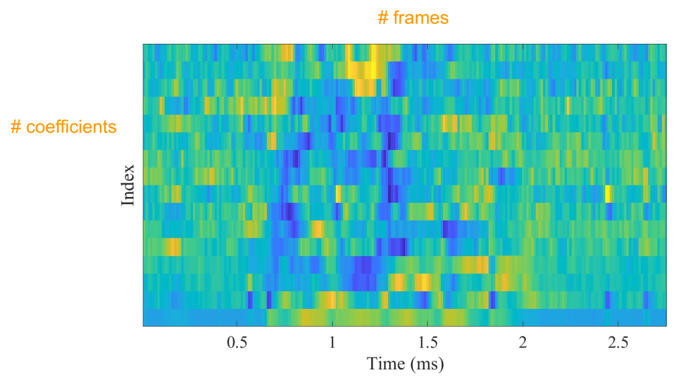
Acoustic features: MFCC
[5]
Environmental sound classification using deep learning - Manoj

Slide 17
Approaches
Classical machine learning
KNN
SVM
Naive bayes
Random forest
Gradient boosting
XG boost
Deep learning
Transfer learning
VGG model - Freezing each block and training
Random samples from data
Equal splitting of data
Environmental sound classification using deep learning - Manoj

Slide 18
Data preparation for classical approach
Compute the 20 mfcc features for each audio file.
Environmental sound classification using deep learning - Manoj

Slide 19
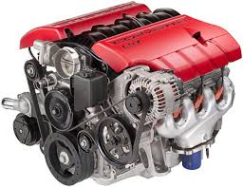
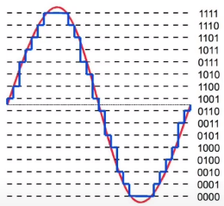
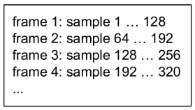
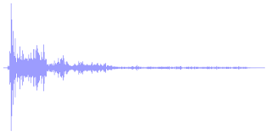
Classical approach pipeline
Classical model with default parameters
Comparison of results
Classical model with hyperparameter tuning
Environmental sound classification using deep learning - Manoj

Slide 20
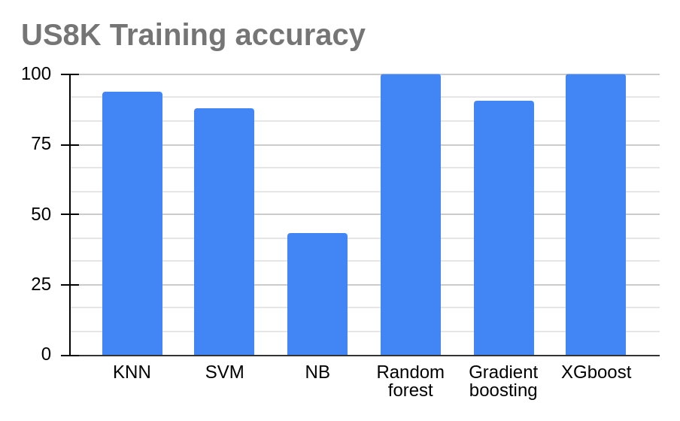
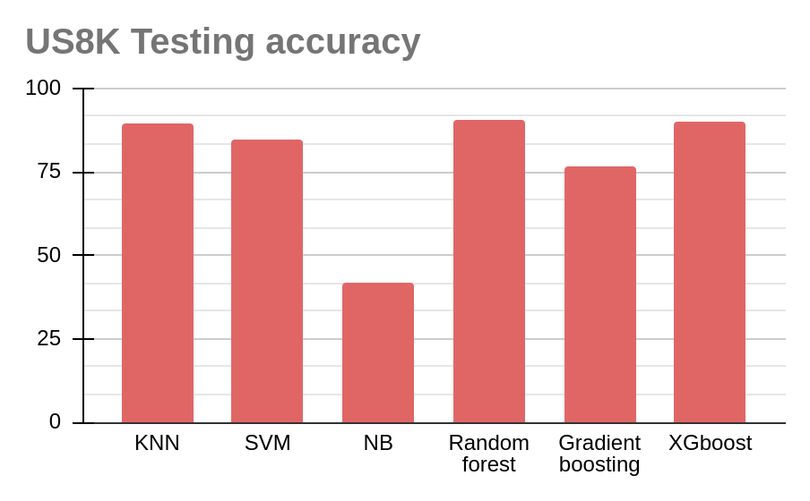
Classical approach - Urbansound8k(US8K)
Default parameter
Environmental sound classification using deep learning - Manoj

Slide 21
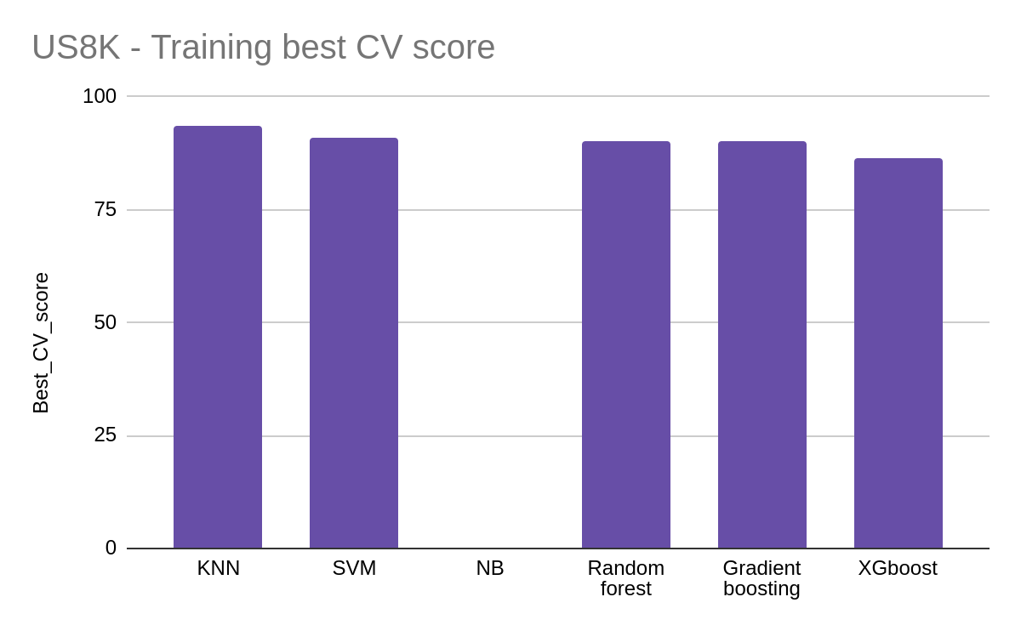
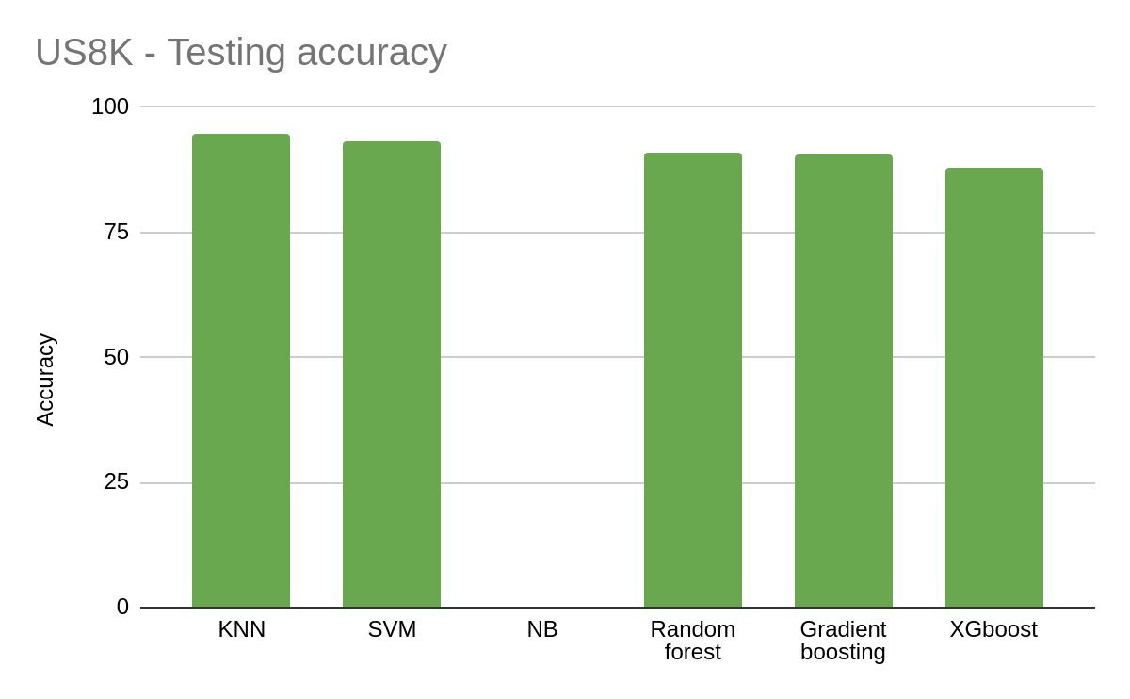
Classical approach - Urbansound8k(US8K)
Optimized parameter
Environmental sound classification using deep learning - Manoj

Slide 22
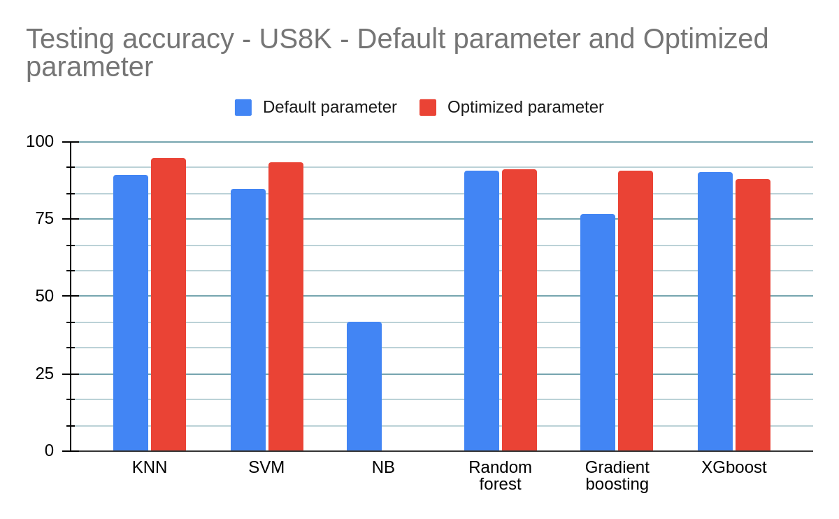
Classical approach - Urbansound8k(US8K)
Environmental sound classification using deep learning - Manoj

Slide 23
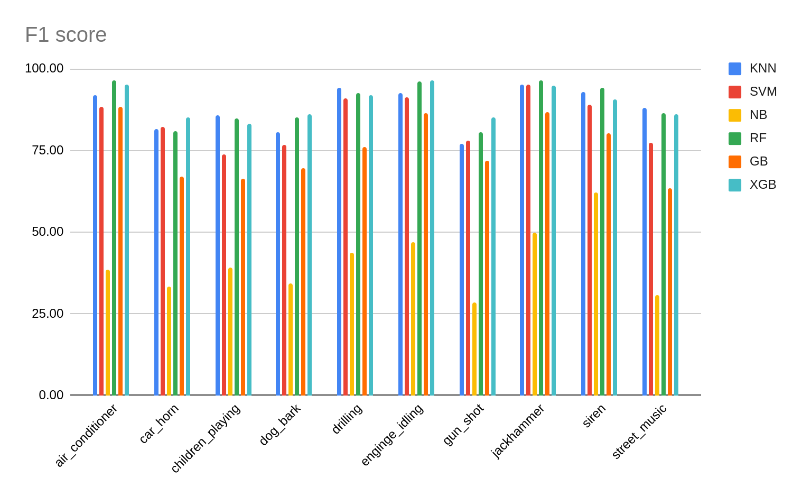
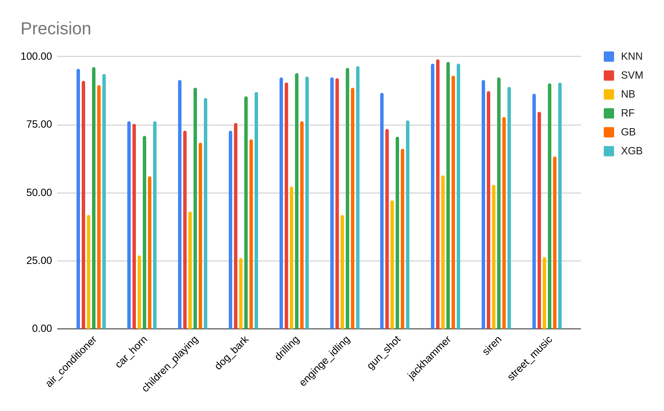
Classical approach - Urbansound8K(US8K)
Default parameter
Environmental sound classification using deep learning - Manoj

Slide 24
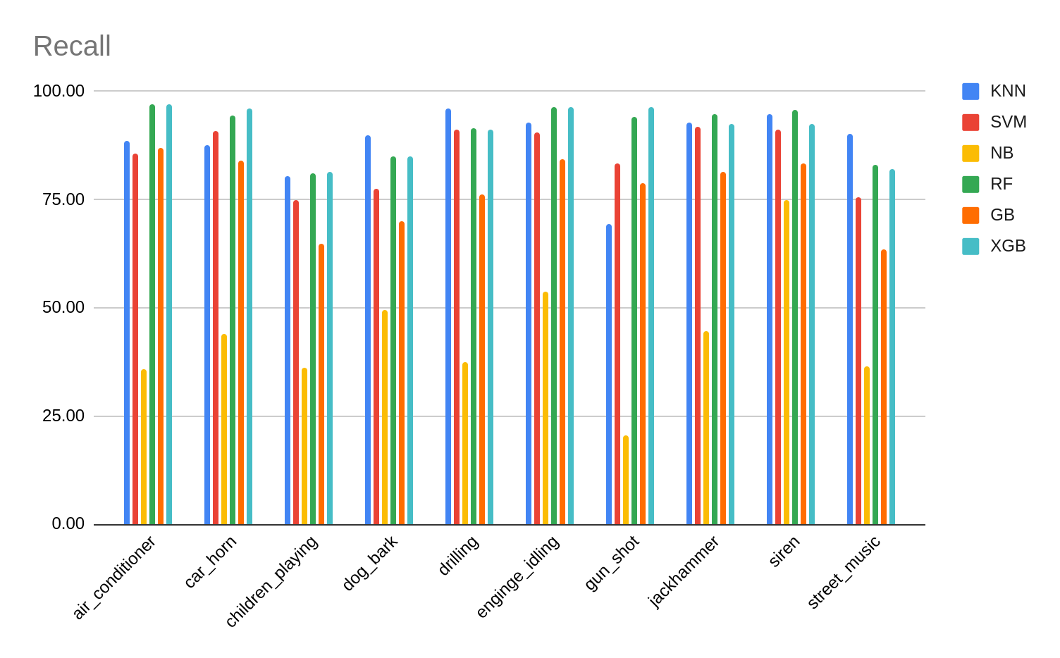
Classical approach - Urbansound8K(US8K)
Default parameter
Environmental sound classification using deep learning - Manoj

Slide 25
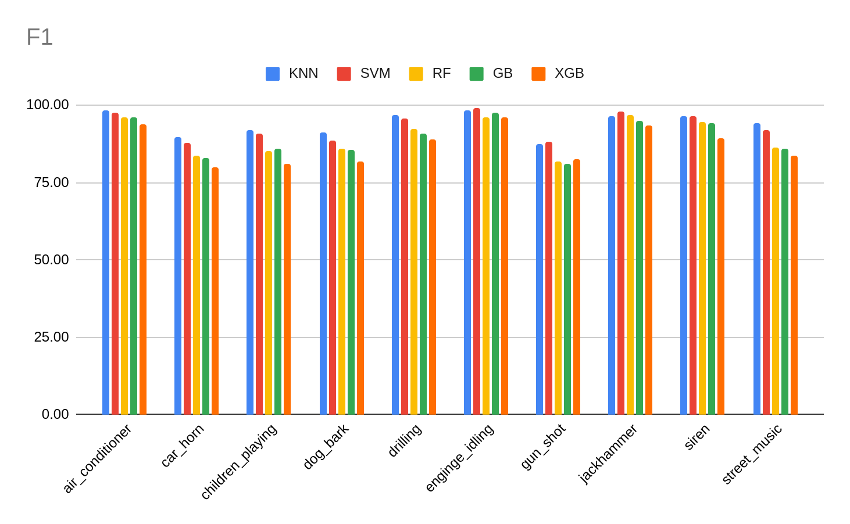
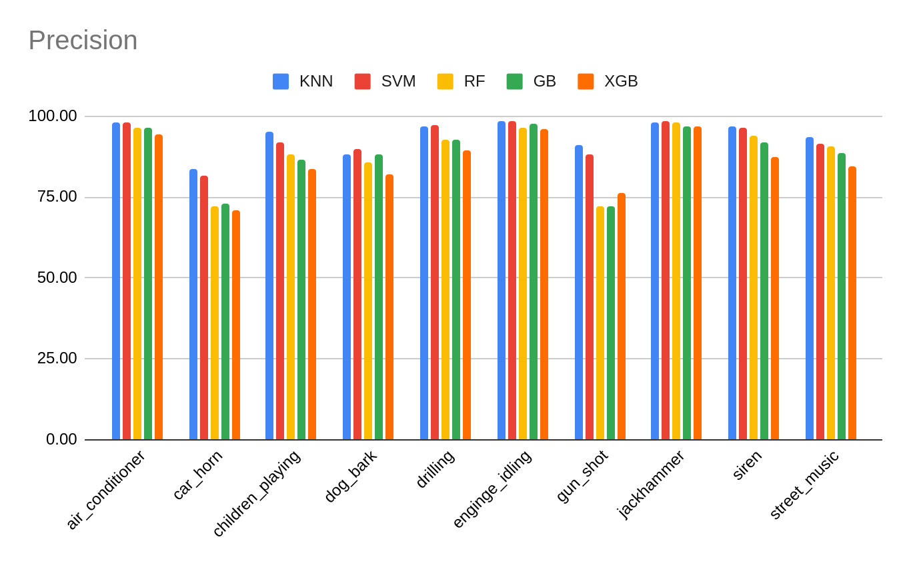
Classical approach - Urbansound8K(US8K)
Optimized parameter
Environmental sound classification using deep learning - Manoj

Slide 26
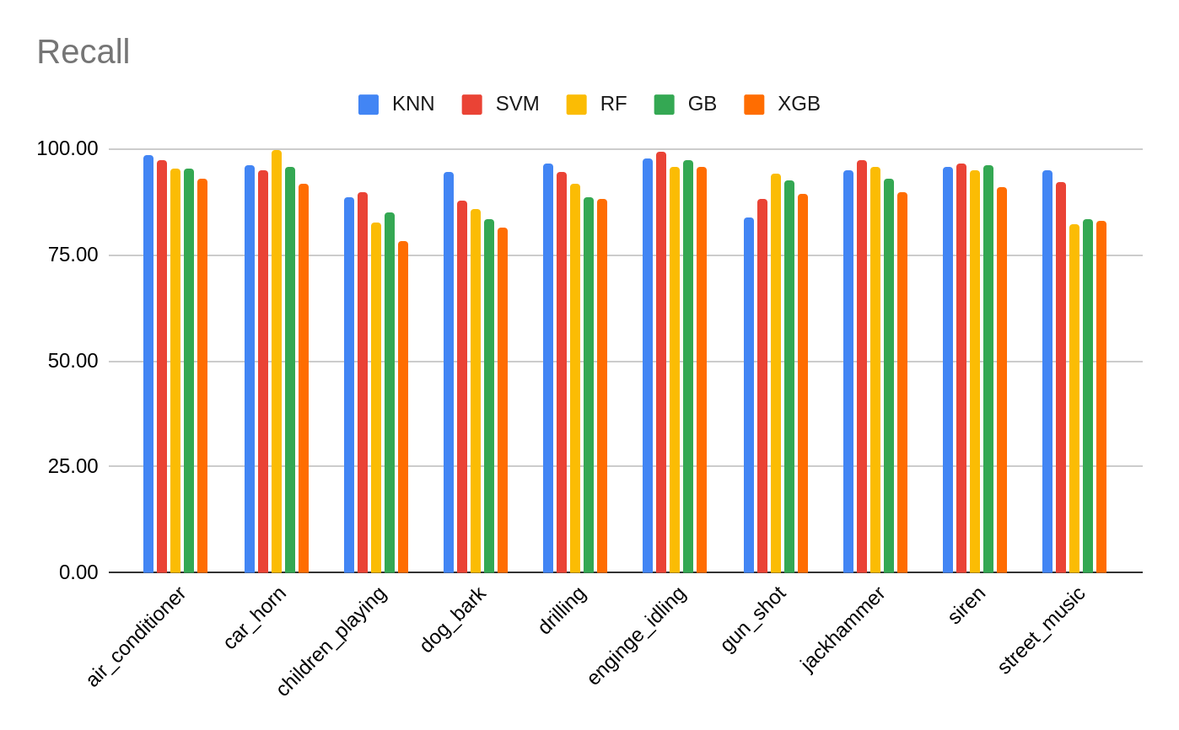
Classical approach - Urbansound8K(US8K)
Optimized parameter
Environmental sound classification using deep learning - Manoj

Slide 27
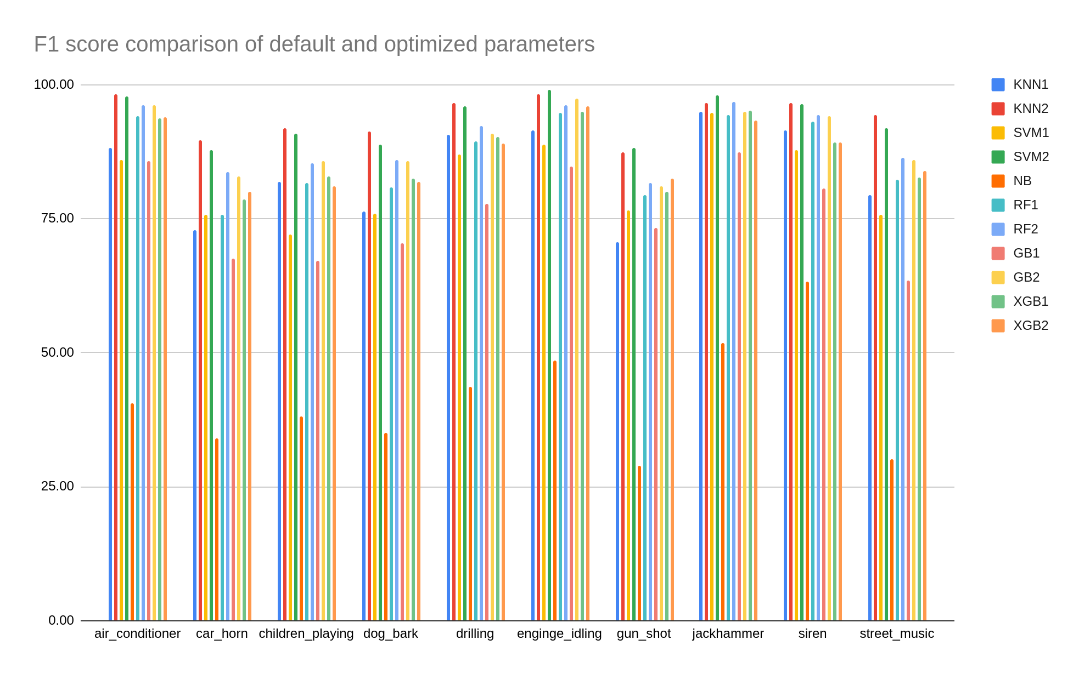
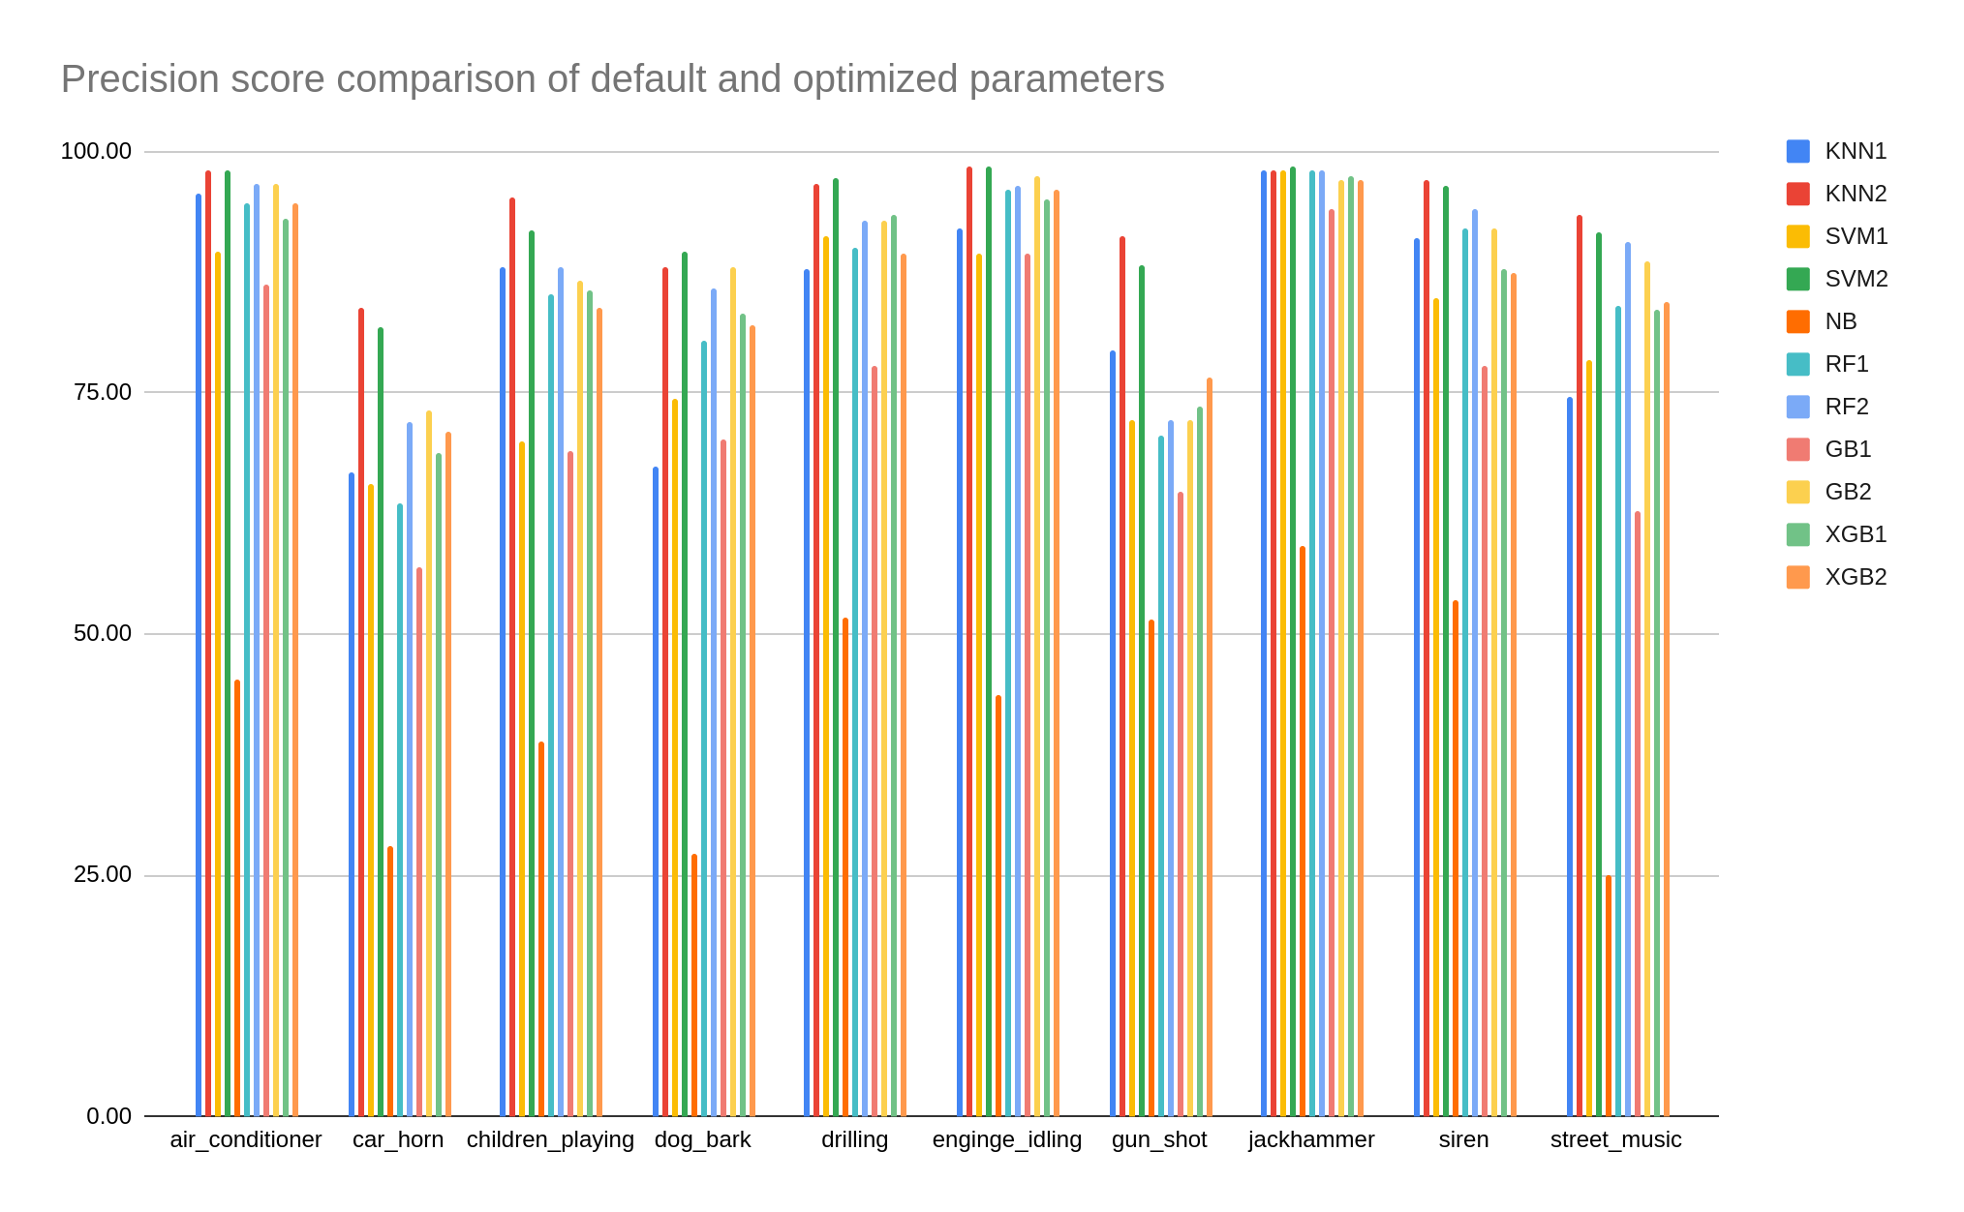
Classical approach - Urbansound8K(US8K)
Environmental sound classification using deep learning - Manoj

Slide 28
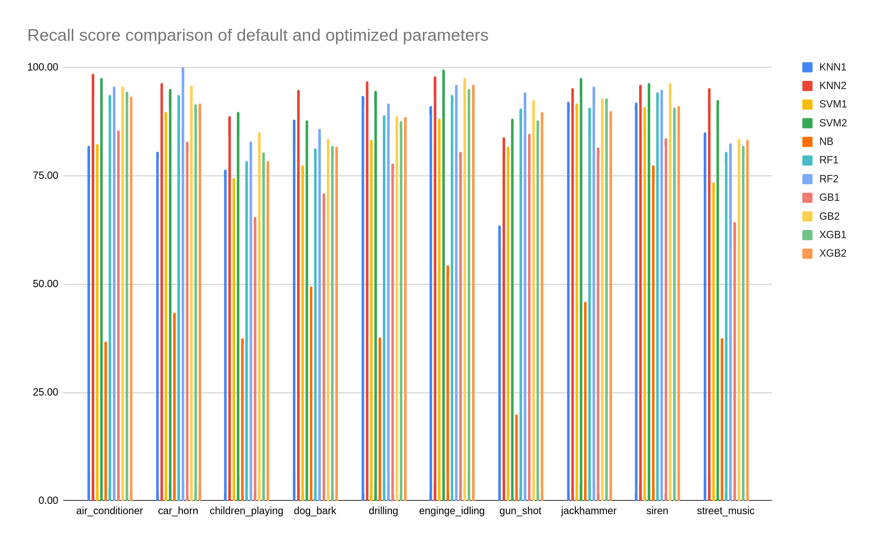
Classical approach - Urbansound8K(US8K)
Environmental sound classification using deep learning - Manoj

Slide 29
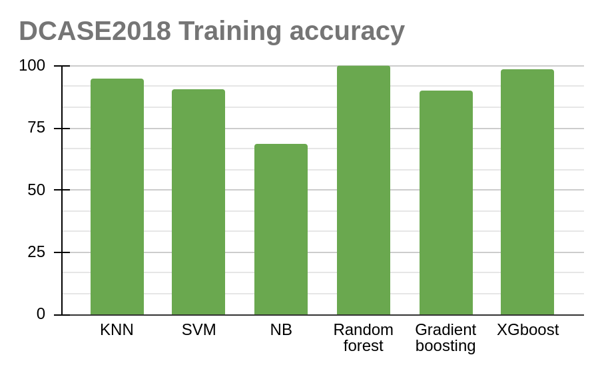
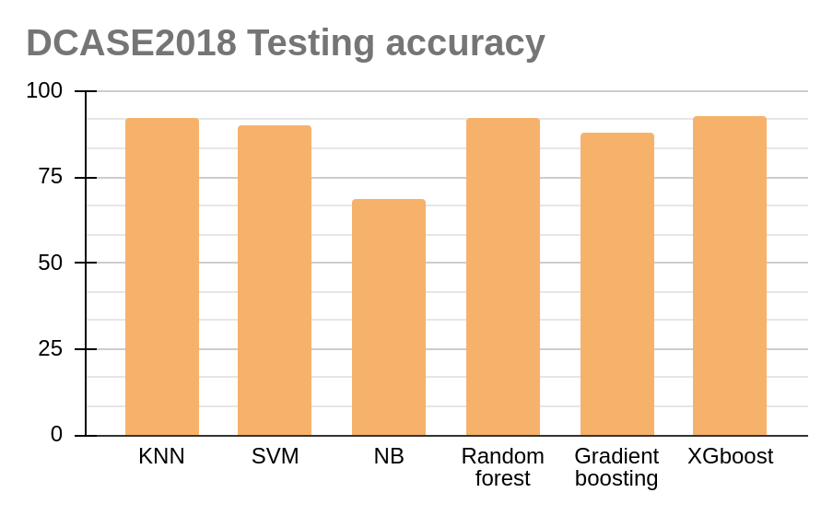
Classical approach - DCASE2018
Default parameter
Environmental sound classification using deep learning - Manoj

Slide 30
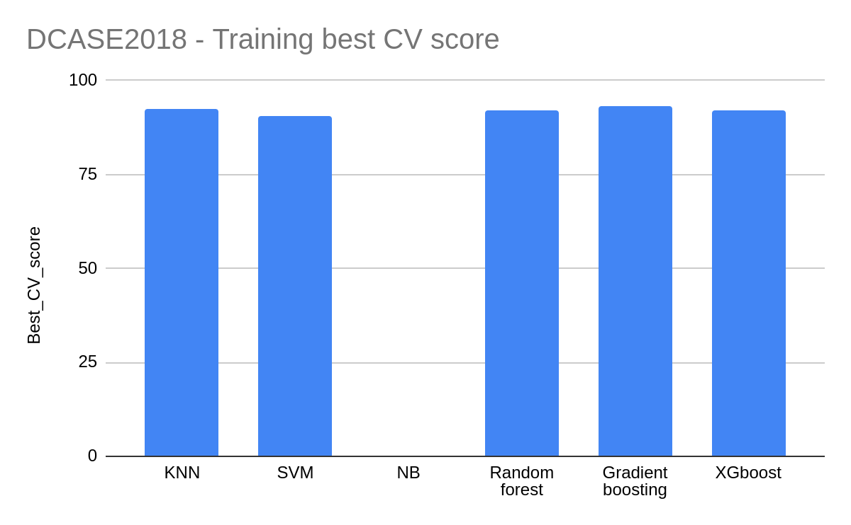
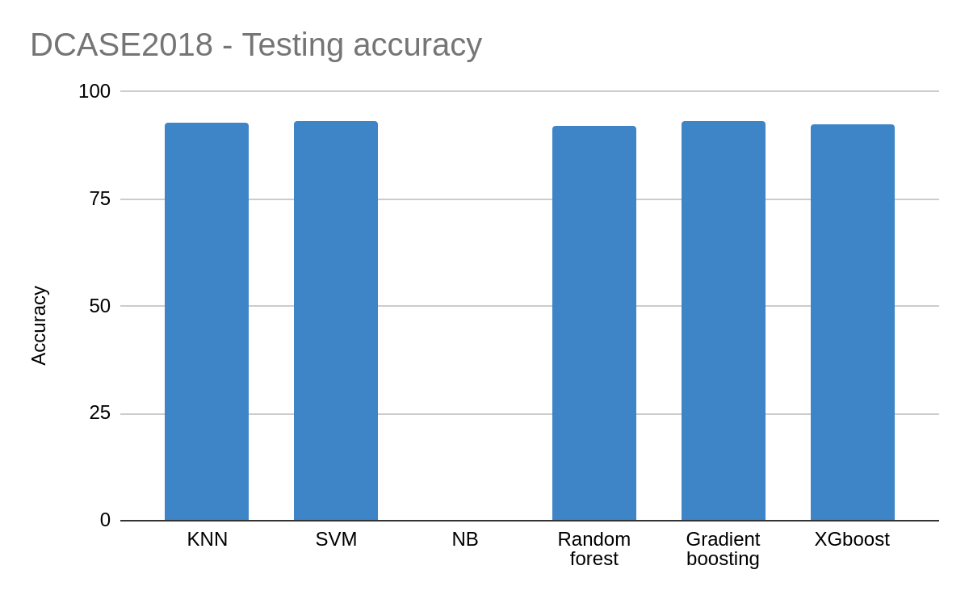
Classical approach - DCASE2018
Optimized parameter
Environmental sound classification using deep learning - Manoj

Slide 31
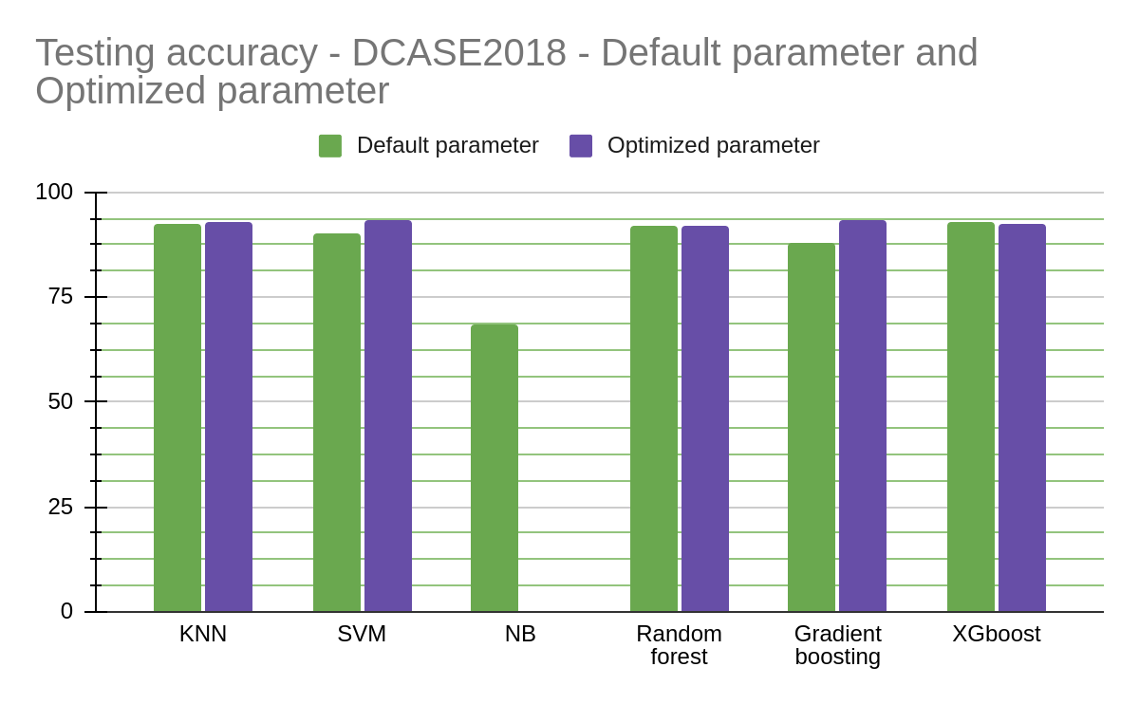
Classical approach - DCASE2018
Environmental sound classification using deep learning - Manoj

Slide 32
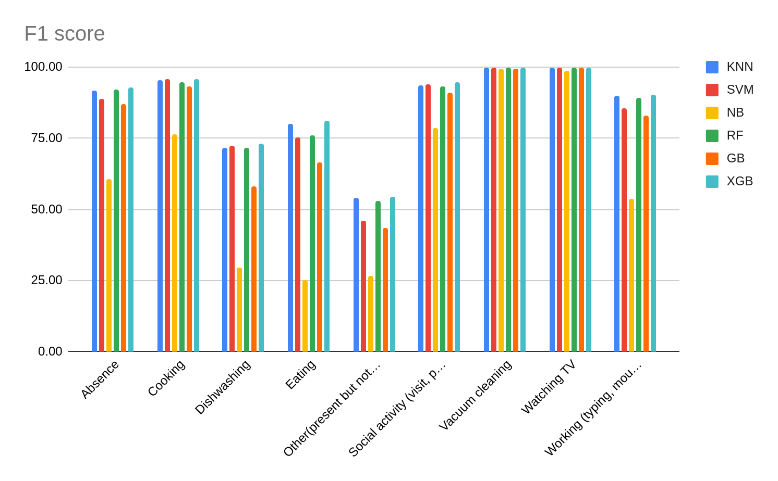
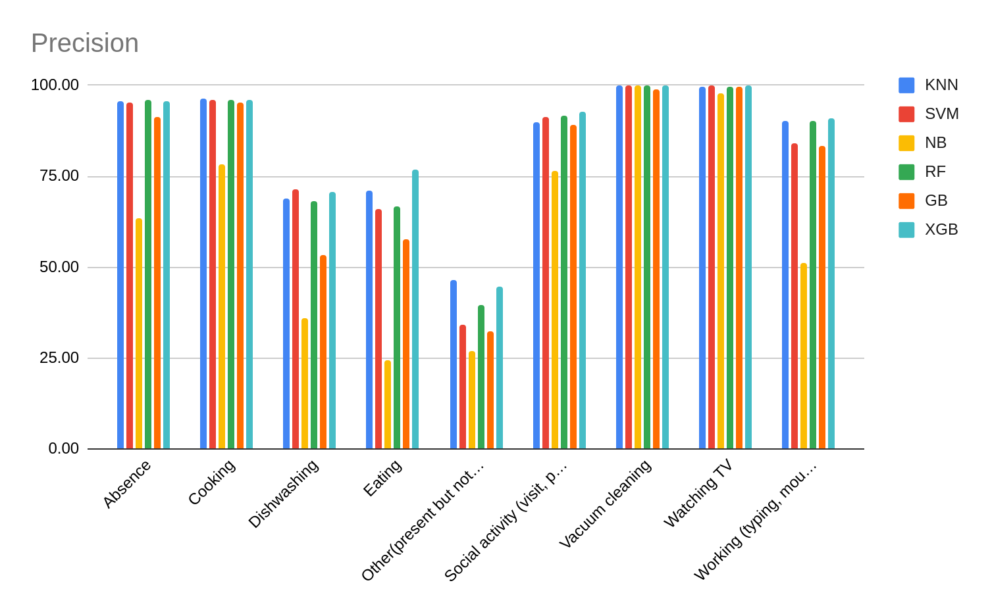
Classical approach - DCASE2018
Default parameter
Environmental sound classification using deep learning - Manoj

Slide 33
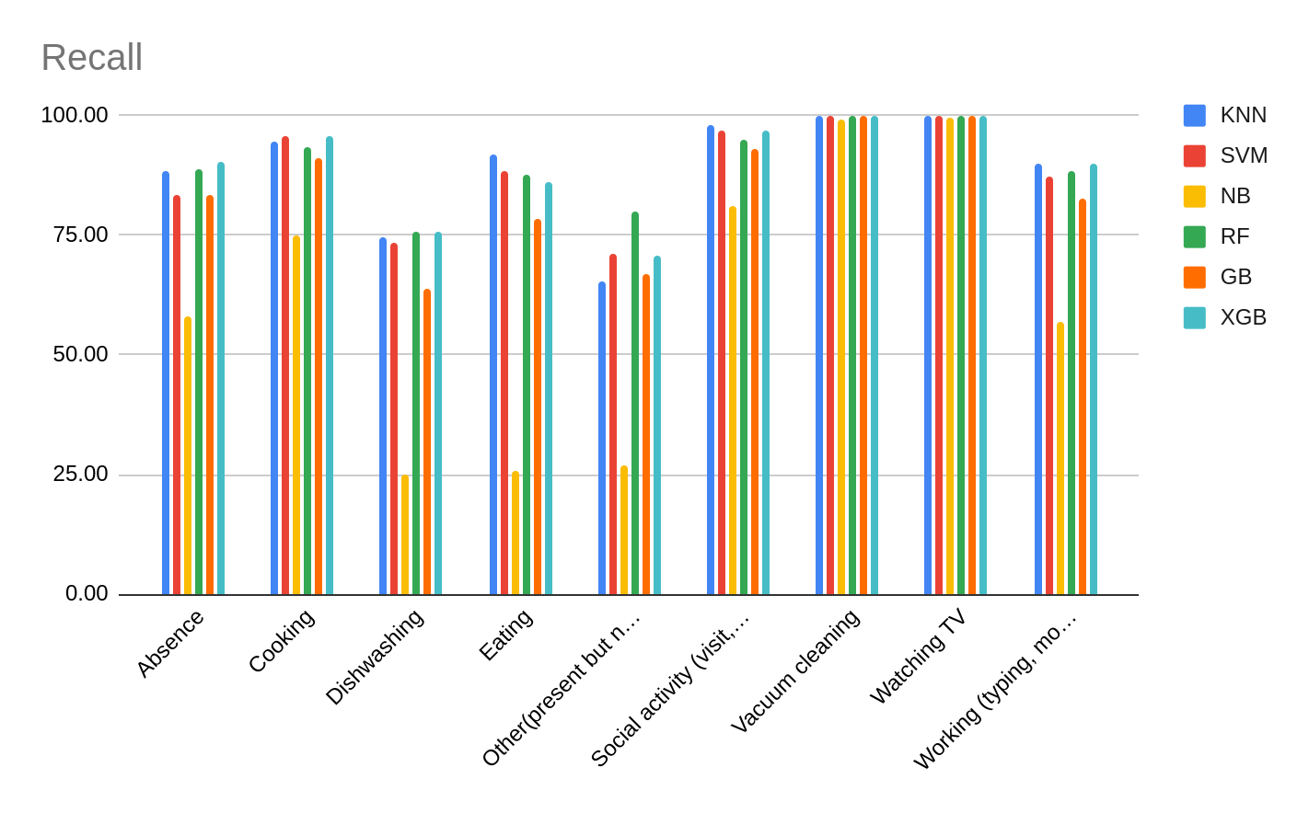
Classical approach - DCASE2018
Default parameter
Environmental sound classification using deep learning - Manoj

Slide 34
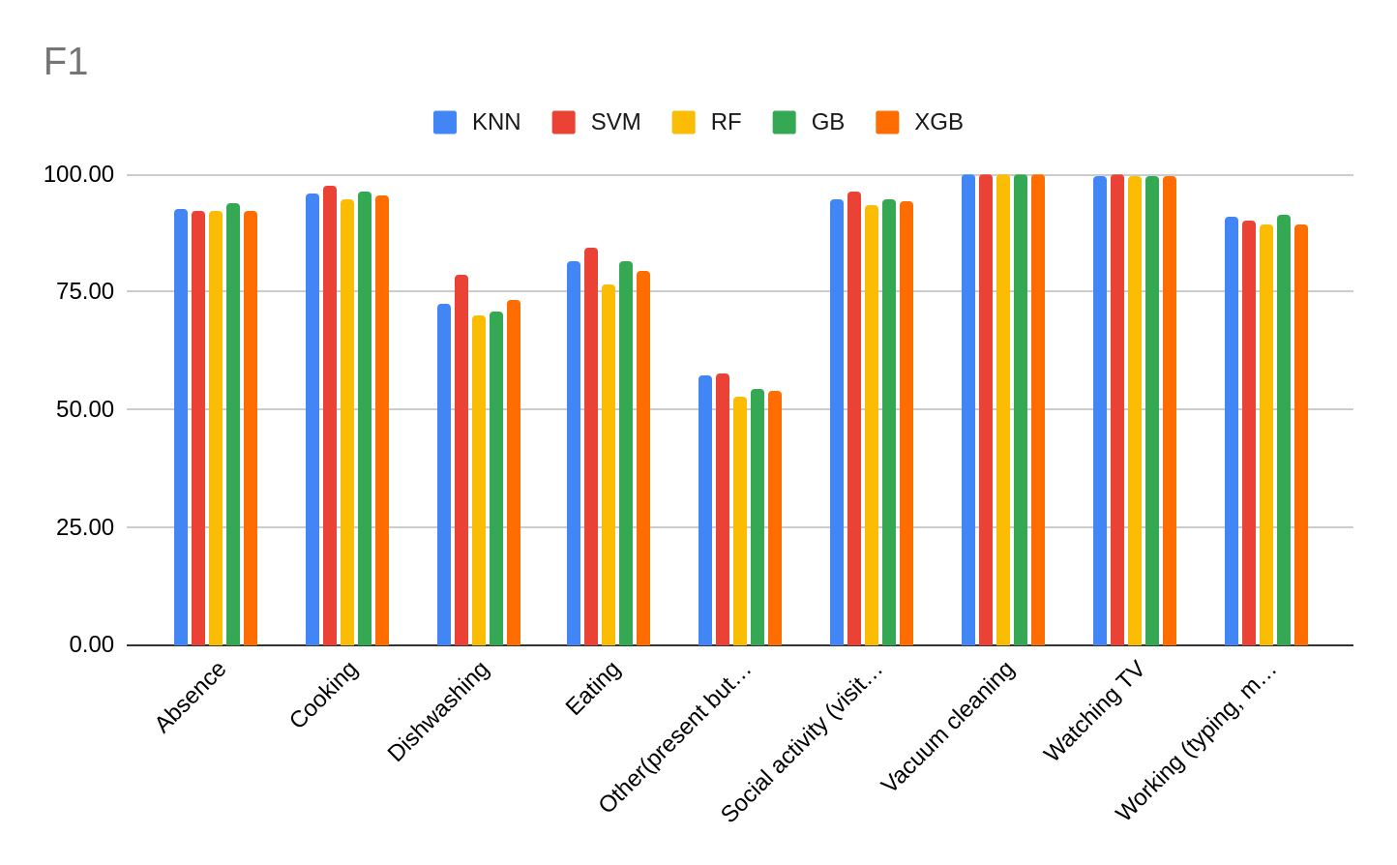

Classical approach - DCASE2018
Optimized parameter
Environmental sound classification using deep learning - Manoj

Slide 35

Classical approach - DCASE2018
Optimized parameter
Environmental sound classification using deep learning - Manoj

Slide 36


Classical approach - DCASE2018
Environmental sound classification using deep learning - Manoj

Slide 37

Classical approach - DCASE2018
Environmental sound classification using deep learning - Manoj

Slide 38


KNN - Urbansound8k
Environmental sound classification using deep learning - Manoj

Slide 39


KNN - Dcase 2018
Environmental sound classification using deep learning - Manoj

Slide 40


SVM - Urbansound8K
Environmental sound classification using deep learning - Manoj

Slide 41


SVM - DCASE -2018
Environmental sound classification using deep learning - Manoj

Slide 42


Naive bayes - Urabnsound8K and DCASE -2018
MFCC as the extracted features of each audio using librosa library.
Extracted mfcc features are fed into the naive bayes classifier.
Environmental sound classification using deep learning - Manoj

Slide 43


Random forest - Urbansound8K
Environmental sound classification using deep learning - Manoj

Slide 44


Random forest - DCASE2018
Environmental sound classification using deep learning - Manoj

Slide 45


Gradient boosting - Urbansound8K
Environmental sound classification using deep learning - Manoj

Slide 46


Gradient boosting - DCASE2018
Environmental sound classification using deep learning - Manoj

Slide 47


XG boosting - Urbansound8K
Environmental sound classification using deep learning - Manoj

Slide 48


XG boosting - DCASE2018
Environmental sound classification using deep learning - Manoj

Slide 49
Transfer learning Pipeline
Log mel spectrogram is generated using librosa framework
VGGish model [Pre-trained with audioset dataset]
Generate samples from the log mel spectrogram
SVM classifier
Generate audio embeddings
Environmental sound classification using deep learning - Manoj

Slide 50


VGGish model
Environmental sound classification using deep learning - Manoj

Slide 51

VGGish model trained with audioset
Environmental sound classification using deep learning - Manoj

Slide 52



VGGish model trained with audioset
AudioSet consists of an expanding ontology of 632 audio event classes
A collection of 2,084,320 human-labeled 10-second sound clips drawn from YouTube videos.
Environmental sound classification using deep learning - Manoj

Slide 53
VGGish as feature extractor - Urbansound8k
Randomly sampling 960ms clip from the input audio.
Total samples = 4642*80+2851*80 = 228080 + 371360 = 599440 (Training: 4642*80 = 371360, Testing = 2851*80 = 228080). 98% of data is used for training and 1% data for validation and 1% data for testing.
The 960 ms frames are decomposed with a short-time Fourier transform applying 25 ms windows every 10 ms.
The resulting spectrogram is integrated into 64 mel-spaced frequency bins.
This gives log-mel spectrogram patches of 96 × 64 bins that form the input to the VGGish model.
The VGGish model is considered without the fully connected layer.
VGGish converts audio input features into a semantically meaningful, high-level 512-D embedding that is fed as input to a downstream classification model.
SVM as a classifier with C = 0.01
Model score: 0.495
Environmental sound classification using deep learning - Manoj

Slide 54


VGGish as feature extractor - Urbansound8k
Environmental sound classification using deep learning - Manoj

Slide 55

VGGish as feature extractor - Urbansound8k
Environmental sound classification using deep learning - Manoj

Slide 56

VGGish as feature extractor - Urbansound8k
Due to the poor performance of the pretrained VGGish model the weights of the model needs to be adjusted to the new dataset.

Slide 57

VGGish as feature extractor - Urbansound8k
Environmental sound classification using deep learning - Manoj

Slide 58
VGGish as feature extractor - Urbansound8k
Common to all three training process:
Randomly sampling 960ms clip from the input audio.
Total samples: 599440 (Training: 4642*80 = 371360, Testing = 2851*80 = 228080)
The 960 ms frames are decomposed with a short-time Fourier transform applying 25 ms windows every 10 ms.
The resulting spectrogram is integrated into 64 mel-spaced frequency bins.
This gives log-mel spectrogram patches of 96 × 64 bins that form the input to the VGGish model.
Training 1:
Freeze block 1&2&3: https://wandb.ai/manojkl/vgg_training_03?workspace=user-manojkl
Freeze block 1&2: https://wandb.ai/manojkl/vgg_training_04_1&2_frozen_layer?workspace=user-manojkl
Freeze block 1: https://wandb.ai/manojkl/vgg_training_04_first_frozen_layer?workspace=user-manojkl
Environmental sound classification using deep learning - Manoj

Slide 59
VGGish as feature extractor - DCASE2018
Common to all three training process:
Randomly sampling 960ms clip from the input audio.
Total samples: 2,165,759
The 960 ms frames are decomposed with a short-time Fourier transform applying 25 ms windows every 10 ms.
The resulting spectrogram is integrated into 64 mel-spaced frequency bins.
This gives log-mel spectrogram patches of 96 × 64 bins that form the input to the VGGish model.
Training 1:
Freeze block 1&2&3: https://wandb.ai/manojkl/vgg_training_01_dcase_1&2&3_frozen_layer?workspace=user-manojkl
Freeze block 1&2: https://wandb.ai/manojkl/vgg_training_01_dcase_1&2_frozen_layer?workspace=user-manojkl
Freeze block 1: https://wandb.ai/manojkl/vgg_training_01_dcase_1_frozen_layer?workspace=user-manojkl
Environmental sound classification using deep learning - Manoj

Slide 60
VGGish as feature extractor - Urbansound8k
Common to all three training process:
Equally divide the entire audio frame into 960ms clip from the input audio.
Total samples: 21001
The 960 ms frames are decomposed with a short-time Fourier transform applying 25 ms windows every 10 ms.
The resulting spectrogram is integrated into 64 mel-spaced frequency bins.
This gives log-mel spectrogram patches of 96 × 64 bins that form the input to the VGGish model.
Training 1:
Freeze block 1&2&3: https://wandb.ai/manojkl/vgg_training_all_data_01?workspace=user-manojkl
Freeze block 1&2: https://wandb.ai/manojkl/vgg_training_1&2_frozen_layer_all_data_03?workspace=user-manojkl
Freeze block 1: https://wandb.ai/manojkl/vgg_training_first_frozen_layer_all_data_02?workspace=user-manojkl
Environmental sound classification using deep learning - Manoj

Slide 61
VGGish as feature extractor - DCASE2018
Common to all three training process:
Equally divide the entire audio frame 960ms clip from the input audio.
Total samples: 722,205
The 960 ms frames are decomposed with a short-time Fourier transform applying 25 ms windows every 10 ms.
The resulting spectrogram is integrated into 64 mel-spaced frequency bins.
This gives log-mel spectrogram patches of 96 × 64 bins that form the input to the VGGish model.
Training 1:
Freeze block 1&2&3: https://wandb.ai/manojkl/vgg_training_dcase_1&2&3_frozen_layer_all_data_01?workspace=user-manojkl
Freeze block 1&2: https://wandb.ai/manojkl/vgg_training_dcase_1&2_frozen_layer_all_data_02?workspace=user-manojkl
Freeze block 1: https://wandb.ai/manojkl/vgg_training_dcase_1st_frozen_layer_all_data_03?workspace=user-manojkl
Environmental sound classification using deep learning - Manoj

Slide 62
Options
Train a classification model with the original dataset. Generate audio embeddings with the VGGish model and give it as a input to the trained classifier for prediction of classes.
Environmental sound classification using deep learning - Manoj

Slide 63
LSTM
Random clip
Entire image
Environmental sound classification using deep learning - Manoj

Slide 64
LSTM Pipeline
Random clip
Entire image
Environmental sound classification using deep learning - Manoj

Slide 65
Hybrid model CNN+LSTM Pipeline
Random clip
Entire image
Environmental sound classification using deep learning - Manoj

Slide 66
Hybrid model CNN+LSTM
Random clip
Entire image
Environmental sound classification using deep learning - Manoj

Slide 67
KNN - Urbansound8k
Environmental sound classification using deep learning - Manoj

Slide 68
KNN - Dcase 2018
Environmental sound classification using deep learning - Manoj

Slide 69
SVM - Urbansound8K
MFCC as the extracted features of each audio using librosa library.
Environmental sound classification using deep learning - Manoj

Slide 70
SVM - DCASE -2018
Environmental sound classification using deep learning - Manoj

Slide 71
Random forest - Urbansound8K
Optimized parameter
Environmental sound classification using deep learning - Manoj

Slide 72
Random forest - DCASE2018
Optimized parameter
Environmental sound classification using deep learning - Manoj

Slide 73
Gradient boosting - Urbansound8K
Parameter
Environmental sound classification using deep learning - Manoj

Slide 74
Gradient boosting - DCASE2018
Parameter
Environmental sound classification using deep learning - Manoj

Slide 75
XG boosting - Urbansound8K
Parameters
Environmental sound classification using deep learning - Manoj

Slide 76
XG boosting - DCASE2018
Parameters
Environmental sound classification using deep learning - Manoj

Slide 77
Reference
Su, Y., Zhang, K., Wang, J., & Madani, K. (2019). Environment sound classification using a two-stream CNN based on decision-level fusion. Sensors, 19(7), 1733.
Lim, Hyungui, Jeongsoo Park, and Yoonchang Han. "Rare sound event detection using 1D convolutional recurrent neural networks." Proceedings of the Detection and Classification of Acoustic Scenes and Events 2017 Workshop. 2017.
https://urbansounddataset.weebly.com/urbansound8k.html
http://dcase.community/challenge2018/task-monitoring-domestic-activities
https://github.com/musikalkemist/AudioSignalProcessingForML
Environmental sound classification using deep learning - Manoj

